Slide 1
IT1020 – Introduction to computer systems
Lecture 4:
Operating systems

Slide 2
Lecture outline
What Operating Systems Do
Computer-System Organization
Operating-System Structure
Operating-System Operations
Process, Memory & Storage Management
Protection and Security
Computing Environments
Open-Source Operating Systems

Slide 3
What is an Operating System
A program that acts as an intermediary between a user of a computer and the computer hardware.
Operating system goals:
Execute user programs and make solving user problems easier
Make the computer system convenient to use
Manage the computer hardware in an efficient manner

Slide 4
Operating-System Structure
Computer system can be divided into four components:
Hardware – provides basic computing resources
CPU, memory, I/O devices
Operating system
Controls and coordinates use of hardware among various applications and users
Application programs – define the ways in which the system resources are used to solve the computing problems of the users
Word processors, compilers, web browsers, database systems, video games
Users
People, machines, other computers

Slide 5
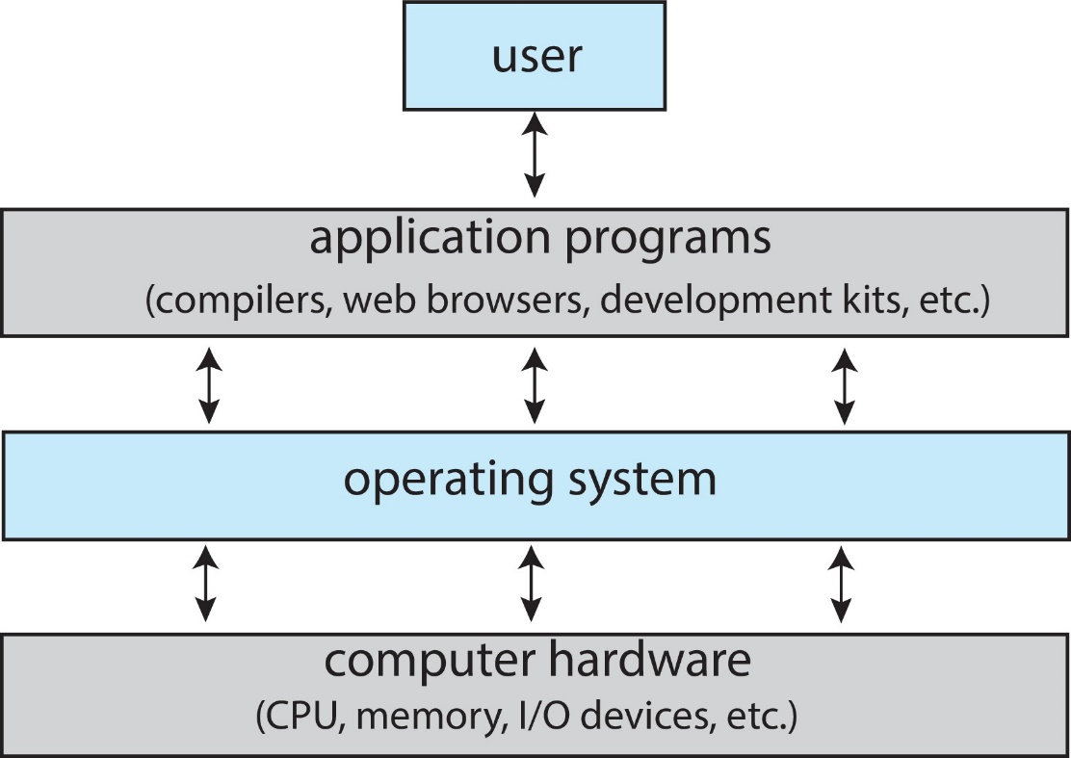
Operating-System Structure

Slide 6
Purposes of an Operating System
Provide the environment for program execution and development
Manage the resources (CPU, memory, I/O devices, hard disk, files etc..)
Provide the access controlling (username and password)

Slide 7
Computer-Start up – booting process
Bootstrap program is loaded at power-up or reboot
Typically stored in ROM or EPROM, generally known as firmware
Initializes all aspects of system (Power on Self Test)
Loads operating system kernel and starts execution

Slide 8
Computer-System Operation
I/O devices and the CPU can execute concurrently
Each device controller is in charge of a particular device type
Each device controller has a local buffer
CPU moves data from/to main memory to/from local buffers
I/O is from the device to local buffer of controller
Device controller informs CPU that it has finished its operation by causing a signal/ an interrupt.

Slide 9

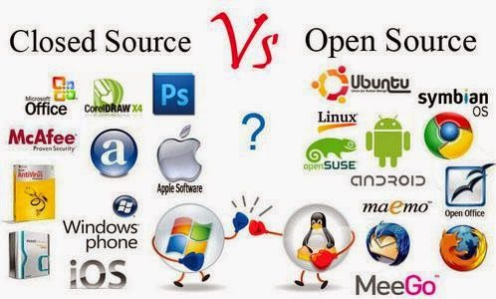
Operating System Software

Slide 10
Types of Operating Systems – multiprogramming operating systems
Multiprogramming (Batch system) needed for efficiency
Single user cannot keep CPU and I/O devices busy at all times
Multiprogramming organizes jobs (code and data) so CPU always has one to execute
A subset of total jobs in system is kept in memory
One job selected and run via job scheduling
When it has to wait (for I/O for example), OS switches to another job

Slide 11
Types of Operating Systems – multitasking/ timesharing operating systems
Timesharing (multitasking) is logical extension in which CPU switches jobs so frequently that users can interact with each job while it is running, creating interactive computing
Response time should be < 1 second
Each user has at least one program executing in memory process
If several jobs ready to run at the same time  CPU scheduling
If processes don’t fit in memory, swapping moves them in and out to run
Virtual memory allows execution of processes not completely in memory

Slide 12
Types of Operating Systems – Real-Time operating systems
These systems are well-defined with a fixed-time constraint – the system is functional if it returns the correct result within the time constraint.
Hard real-time system.
Guarantees that critical tasks complete on time.
Often used as a control device in a dedicated application
controlling scientific experiments, medical imaging systems, industrial control systems, and some display systems
Secondary storage is limited or absent
data is stored in short-term memory, or in ROM.
Soft real-time system
A critical-time task gets priority over others until it completes.
Limited utility in industrial control robotics.
Useful in applications (multimedia) requiring advanced OS features.

Slide 13
Types of Operating Systems– Mobile operating systems
These are the operating systems for smartphones, tablets and wearables.
The system combines the features of a personal computer with additional features useful for a handheld device.
Mobile operating systems start when a device is powered on to provide access to installed applications.
They manage wireless network connectivity.
Leaders are Apple iOS and Google Android, Microsoft windows

Slide 14
OS Components
Process Management
Main-memory management
Secondary-storage management
File Management
I/O System Management
Protection System
Networking (Distributed Systems)
Command- interpreter System

Slide 15
Process Management
A process is a program in execution. Program is a passive entity and process is an active entity.
Process needs resources (CPU, memory, I/O, files) to complete the execution.
Process execution is sequential and program counter register is specifying the location of next instruction to execute.
Process termination requires reclaim of any reusable resources
Process management activities;
Creating and deleting both user and system processes
Suspending and resuming processes
Providing mechanisms for process synchronization
Providing mechanisms for process communication
Providing mechanisms for deadlock handling

Slide 16
Main-Memory Management
To execute a program, it must be in memory.
Memory management determines what is in memory and when
Optimizing CPU utilization and computer response to users
Memory management activities
Keeping track of which parts of memory are currently being used and by whom
Deciding which processes (or parts thereof) and data to move into and out of memory
Allocating and deallocating memory space as needed

Slide 17
Secondary-storage Management
Usually, disks use to store data that does not fit in main memory or data that must be kept for a “long” period of time.
Proper management is of central importance
Storage management activities
Free-space management
Storage allocation
Disk scheduling
Proving a uniform, logical view of data (file)

Slide 18
File Management
Files usually organized into directories
Access control on most systems to determine who can access what
File management activities
Creating and deleting files and directories
Primitives to manipulate files and directories
Mapping files onto secondary storage
Backup files onto stable (non-volatile) storage media

Slide 19
Operating System Services
Provide user interface (UI)
Command line interface – using text commands
Batch interface – commands and their directives are put in a file
Graphical user interface (GUI) – window system with pointing devices
Provide environment for program execution.
OS must load program and run it.
Provide some means to do I/O
User programs cannot execute I/O operations directly.

Slide 20
Operating System Services
Provide mechanism to do file-system manipulation.
Capability to read, write, create, and delete files, directory trees etc.
Provide mechanism for process communication.
Exchange information between processes executing on the same computer or on different systems through a network.
Implemented via shared memory or message passing.
Detect errors and take appropriate actions to ensure correct and consistent computing.
Detect errors in CPU and memory hardware, in I/O devices, or in user programs.

Slide 21
Operating System Services
Resource allocation
Allocating resources to multiple users or multiple jobs running at the same time (CPU scheduling, etc.).
Accounting
Keep track of and record which users use how much and what kinds of computer resources for account billing or for accumulating usage statistics .
Protection and security
Ensuring that all access to system resources is controlled (access permissions, etc.).

Slide 22
Operating-System Operations
Dual-mode operation allows OS to protect itself and other system components
User mode and kernel mode
Mode bit provided by hardware
Provides ability to distinguish when system is running user code or kernel code
Some machine instructions that may cause harm are designated (by hardware) as privileged instructions and they can be executed only in monitor mode.
Set to user mode
monitor
user
Set to monitor mode

Slide 23
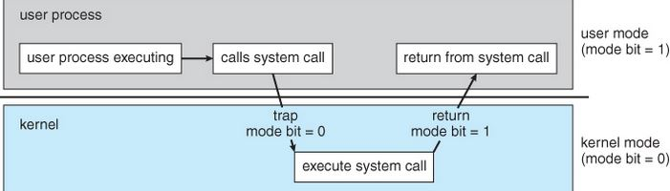
Operating-System Operations
A System call is the way that a computer program requests a service from the kernel. This may include hardware-related services changes mode to monitor/ kernel, return from call resets it to user.

Slide 24
Interrupts
Operating systems are Interrupt driven.
Three types;
Hardware interrupts – generated by hardware devices.
Software interrupt – generated by programs when they are executing system calls.
Traps – generated by CPU itself to indicate an error.

Slide 25
Computing Environments – Virtualization
Allows operating systems to run applications within other OSes
Vast and growing industry
Emulation used when source CPU type different from target type (i.e. PowerPC to Intel x86)
Generally slowest method
When computer language not compiled to native code – Interpretation
Virtualization – OS natively compiled for CPU, running guest OSes also natively compiled
Consider VMware running WinXP guests, each running applications, all on native WinXP host OS
VMM (virtual machine Manager) provides virtualization services

Slide 26
Computing Environments – Virtualization

Slide 27
Computing Environments – Virtualization
Use cases involve laptops and desktops running multiple OSes for exploration or compatibility
Developing apps for multiple OSes without having multiple systems
QA testing applications without having multiple systems
Executing and managing computer environments within data centers

Slide 28
Computing Environments – Client-Server
The model of a computer network in which many clients (remote computers) request and receive services from a centralized server (host computer).
User requests are accepting by the interface provided by the client systems.
Compute-server receives the requests submitted by the users and the responses are sending to the client to transfer to users.

Slide 29
Computing Environments – Cloud Computing
Delivers computing, storage, even apps as a service across a network
Logical extension of virtualization because it uses virtualization as the base for its functionality.
Amazon EC2 has thousands of servers, millions of virtual machines, petabytes of storage available across the Internet, pay based on usage
Many types
Public cloud – available via Internet to anyone willing to pay
Private cloud – run by a company for the company’s own use
Hybrid cloud – includes both public and private cloud components

Slide 30
Computing Environments – Cloud Computing
Software as a Service (SaaS) – one or more applications available via the Internet (i.e., word processor)
Platform as a Service (PaaS) – software stack ready for application use via the Internet (i.e., a database server)
Infrastructure as a Service (IaaS) – servers or storage available over Internet (i.e., storage available for backup use)

Slide 31
THANK YOU

